Slide 1

Welcome to
St Thomas More Catholic Primary School
Year 6 Curriculum Evening
Miss Fenech and Miss Martin – 6F
Miss Lockwood and Mrs Fouch- 6L

Slide 2

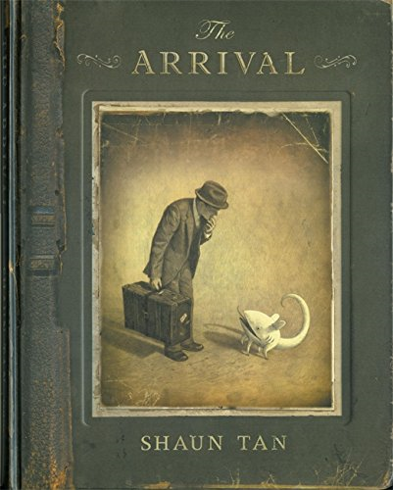
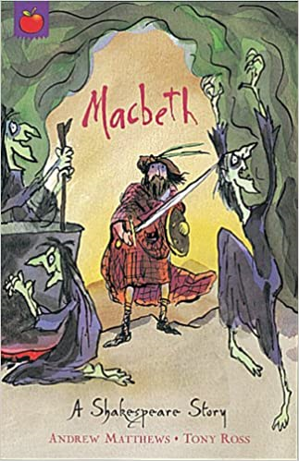


English
Reading, writing, spelling, grammar and punctuation (GPAS) will be taught throughout English lessons. Children will learn to understand genres of writing and the specific GPAS to suit these genres.
For example:
Narrative stories
Recounts – letters, diaries, newspaper reports
Discussions – balanced and persuasive arguments
Procedures – instructions and recipes
Information reports
A selection of books we will read during our time in Year 6.
Please try not to read these at home!

Slide 3
English
Reading
Top tips when reading
Make time each day to sit down together to read.
When choosing a book, try a variety of styles and genres and discuss what interests your child.
Take it in turns to read – not only does this allow your child to develop their fluency and decoding, it lets them develop their listening and understanding skills too.
Discuss the text as you read – find out unfamiliar vocabulary, discuss pictures and question their understanding.
Enjoy getting lost in a new world – reading develops children’s imaginations and opens them up to new ideas and vocabulary. Reading for pleasure is important to help children develop a wealth of skills.
A selection of books we will read during our time in Year 6.
Please try not to read these at home!

Slide 4

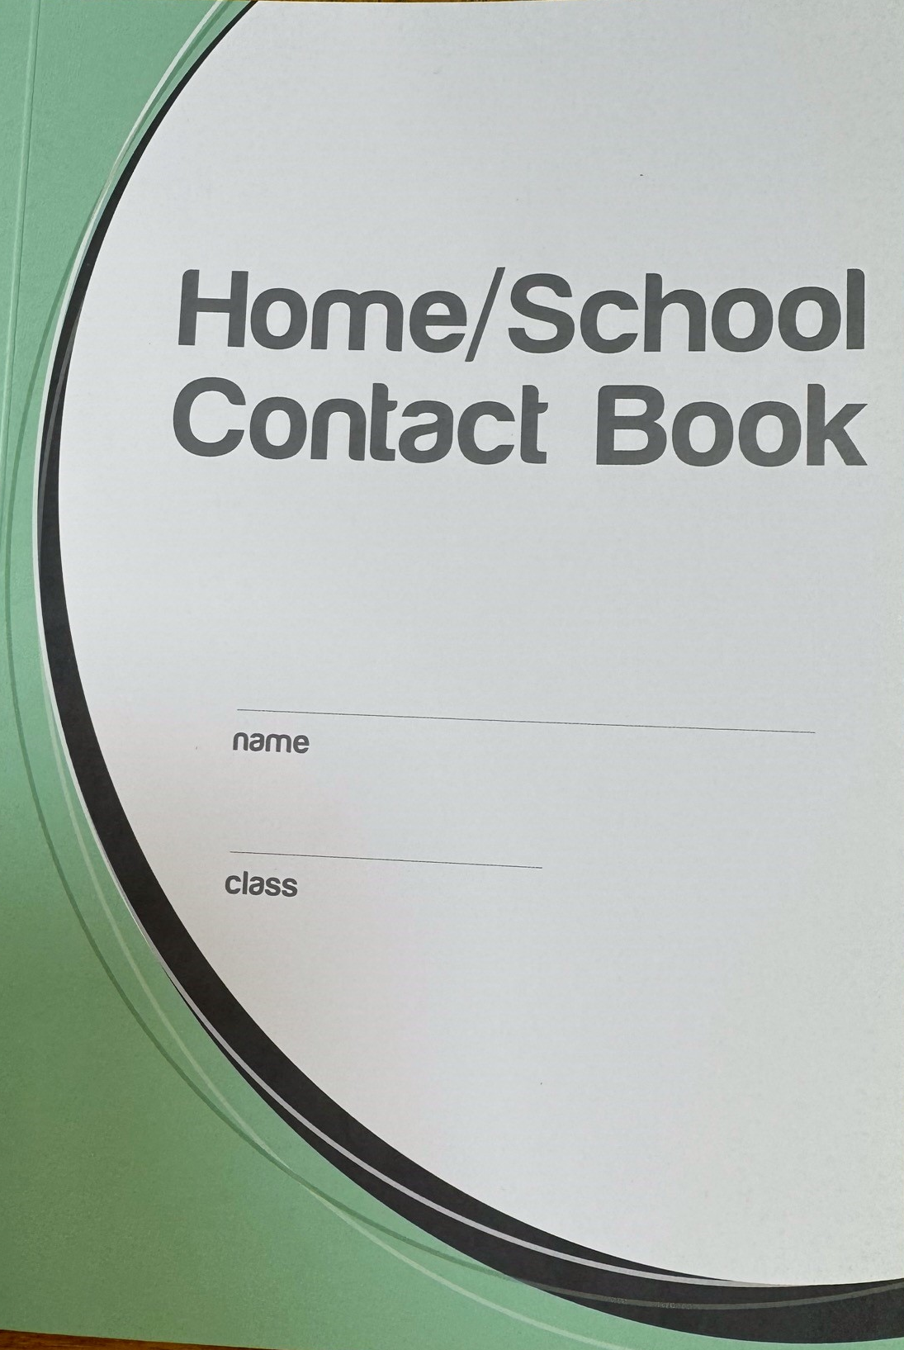
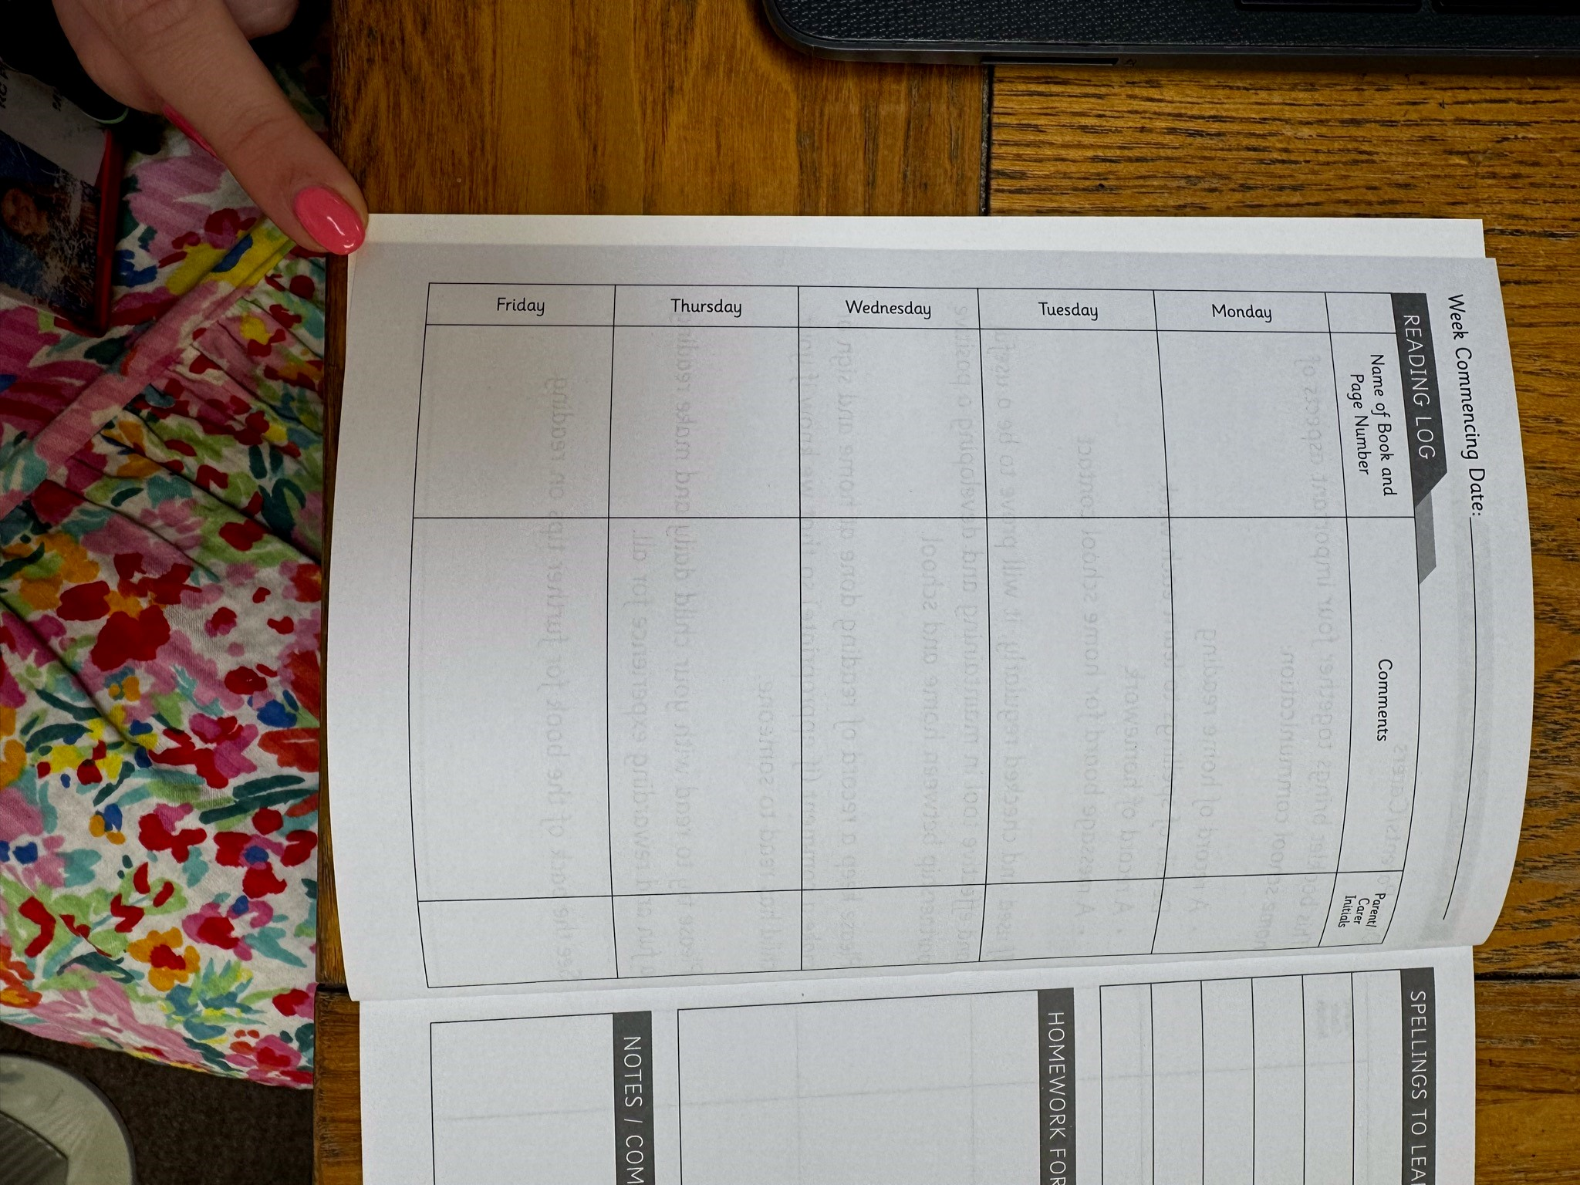
Reading Diaries KS2
In the ‘Reading Log’ section, your child is welcome to complete this independently; however, we kindly ask that an adult oversees the entry and adds their initials beside it to ensure it is being completed accurately.

Slide 5
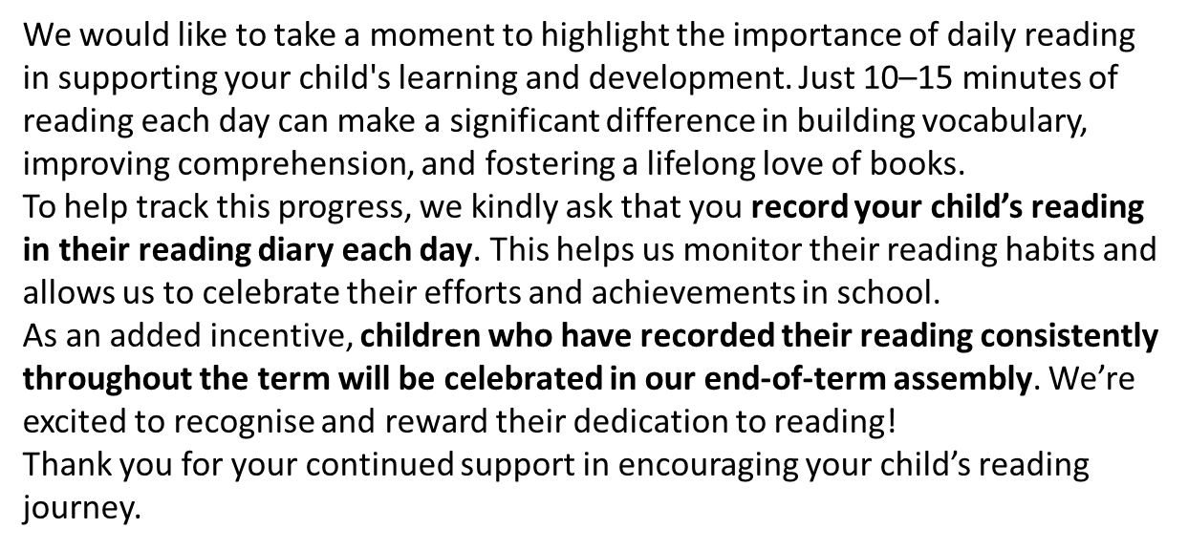
Reading Diaries KS2
Reading diaries must be in school every day (they will come home with the children on Monday). Please use them to record any messages to your child’s teacher and to inform us as to which books your child has been reading
Any notes can also be written in there that you would like us to know about your child, you can also send an email or phone the school office
If you would prefer to catch us in the morning, or afterschool, please wait until the majority of children have gone or are in school before doing so

Slide 6

Reading
Reading impacts all areas of the curriculum. Engaging your child with reading activities is of utmost importance if they are to succeed. Talk to your child about what interests them. Allow them access to a wide range of texts.
Spend at least ten minutes daily sharing or reading with them, visit libraries, look at stories online, download free apps for iPads/ iPods if available and talk about what you have read too!
Here are some ideas of reading materials which you may wish to obtain:
First News (available via newsagents)
Newsround online/BBC stories
Audio books
Holiday brochures
Cookery books
Instruction books (e.g. How to make…)
Fiction stories
Non-fiction
Ipad/ipod free books
Kindle free books

Slide 7

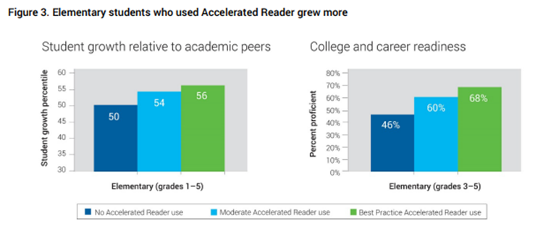
Accelerated Reader
What is Accelerated Reader?
Accelerated Reader (AR) is a reading management and monitoring programme that aims to foster independent reading. The internet-based software assesses reading age, and gives pupils a reading level (ZPD number). Pupils take computerised quizzes on the books and will aim for a quiz target of at least 85%.
Why use Accelerated Reader?
A study found that Year 7 pupils who were offered Accelerated Reader made 3 months’ additional progress in reading compared to other similar pupils. For pupils eligible for free school meals the figure was 5 months’ additional progress.
In primary school, research has shown that pupils using Accelerated Reader make significantly more progress.
How does Accelerated Reader work?
Pupils will be assessed at the beginning of the year on their reading understanding and fluency. This will give them a ZPD number.
Pupils will pick a book to take home based on their ZPD number. Please continue to read with your child as normal and fill in their reading log.
When they finish the book, pupils will take a short quiz in school. Your child’s teacher will monitor your child’s quiz performance and adjust their ZPD number if necessary.

Slide 8
Spelling in Year 6
Children are taught to consolidate and continue their phonic understanding through Spelling Workshop lessons (including etymology, root words, prefixes, suffixes and syllables).
Your children will also be working on the following spelling patterns and rules this year including:
Words ending -cious and -tious such as 'delicious' and 'superstitious'
Words ending -cial and -tial such as 'special' and 'partial'
Words ending -ant, -ance and -ancy such as 'hesitant', 'hesitance' and 'hesitancy'
Words ending -ent, -ence and -ency such as ‘patient’, ‘patience’ and ‘frequency’
Words ending -able / -ably and -ible / -ibly such as 'comfortable' / 'comfortably' and 'horrible' / 'horribly'
Adding -ing / -ed to words ending -fer, for example: 'prefer', 'preferring' and 'preferred'
Use of the hyphen, for example: 'co-ordinate', 're-enter'
Words containing ie / ei, for example: 'piece' and 'ceiling'
Words containing ough and looking at the different sounds this grapheme makes in different words, for example: 'enough', 'through', 'although', 'plough'
Silent letters in words such as 'doubt', 'thistle' and 'knight'
Homophones (words which sound the same but are spelled differently) for example: 'principle' and 'principal'

Slide 9
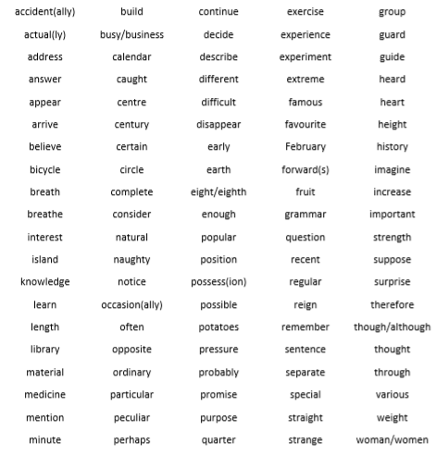
Year 3 and 4 Spellings

Slide 10
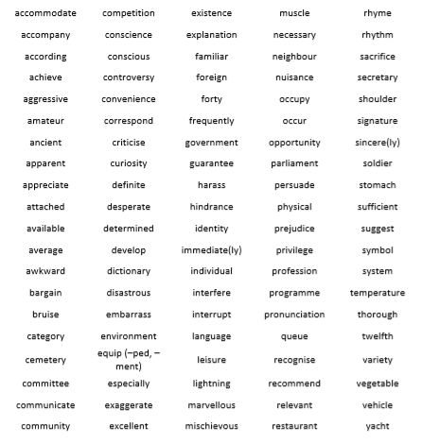
Year 5 and 6 Spellings
In order to meet end of KS2 expectations, children will need to be able to spell these words mostly correctly.

Slide 11
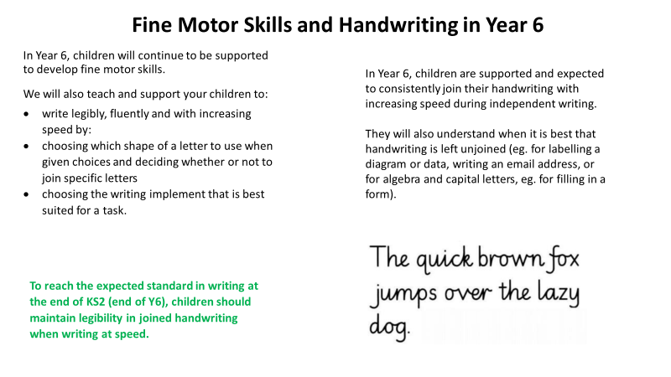

Slide 12

Maths
Children will begin by consolidating their understanding from previous year groups in KS2, as well as learning new concepts from the Year 6 National Curriculum.
These topics will include:
Number
Calculations involving the four operations (+ - x ÷)
Fractions, Decimals and Percentages
Ratio and Proportion
Algebra
Shape, space and measure
Statistics and data handling
Learning multiplication tables will support children’s confidence, recall speed and progress in class. Please support your children to practice these at home!

Slide 13
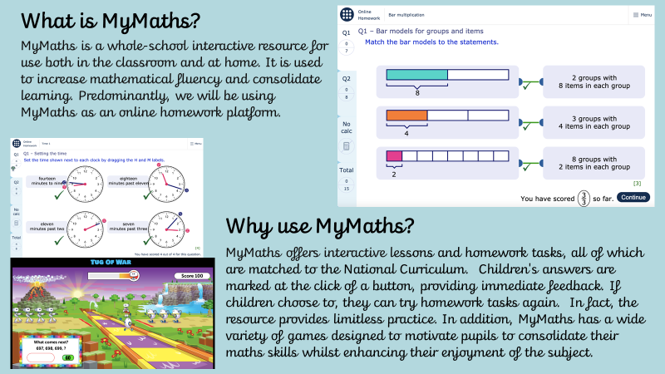

Slide 14
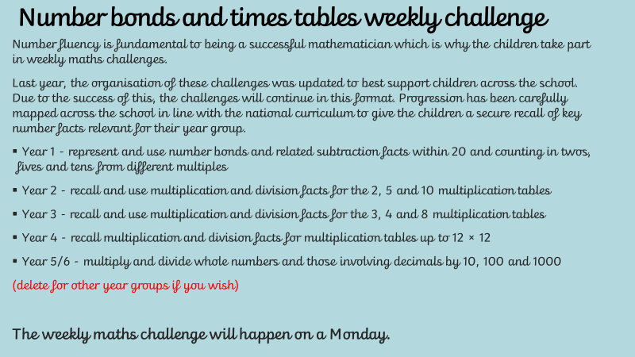

Slide 15
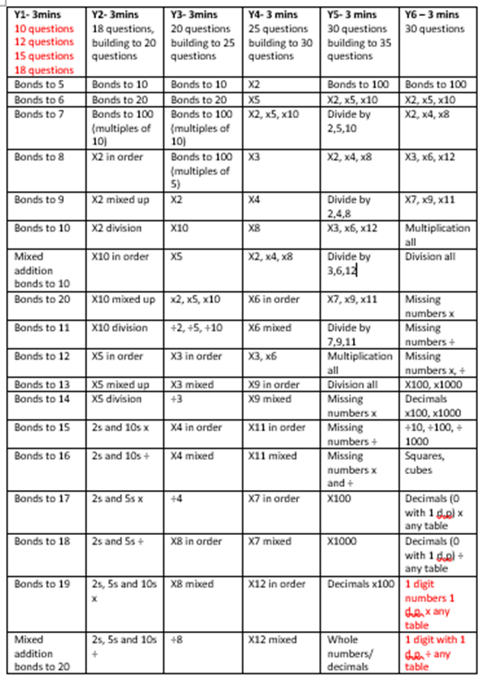
Number bonds and times tables weekly challenge
Number fluency is fundamental to being a successful mathematician which is why the children take part in weekly maths challenges.
This year, the organisation of these challenges has been updated to best support children following on from the multiplication times tables check (MTC) in Year 4.
Progression has been carefully mapped across the school in line with the national curriculum:
Year 1 - represent and use number bonds and related subtraction facts within 20 and counting in twos, fives and tens from different multiples
Year 2 - recall and use multiplication and division facts for the 2, 5 and 10 multiplication tables
Year 3 - recall and use multiplication and division facts for the 3, 4 and 8 multiplication tables
Year 4 - recall multiplication and division facts for multiplication tables up to 12 × 12
Year 5/6 - multiply and divide whole numbers and those involving decimals by 10, 100 and 1000

Slide 16
RE
The curriculum provides opportunities to develop knowledge and understanding of other religions and beliefs. Children are encouraged to be tolerant of others opinions and values.
We will be training the children in the Visio Divinia, which enables the children to lead in their own collective worship.
Our RE topics include:
Loving, vocations and commitments
Expectations
Sources (The Holy Bible)
Unity
Death and New Life
Witnesses
Healing
The Common Good

Slide 17
Science
Animals (including humans)
Light
Electricity
Evolution
Living things and their habitats
Humanities
WWII
Post-war Britain
Earthquakes
The Ancient Maya Civilisation
Traffic survey
Computing
Coding
E-Safety
Blogging
Text Adventures
Networks
Programming
PE
A range of indoor and outdoor skills beginning with hockey (outdoor) and dodgeball (indoor) in Term 1.

Slide 18
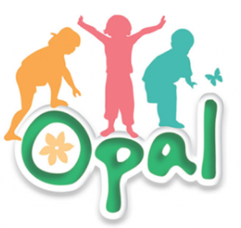
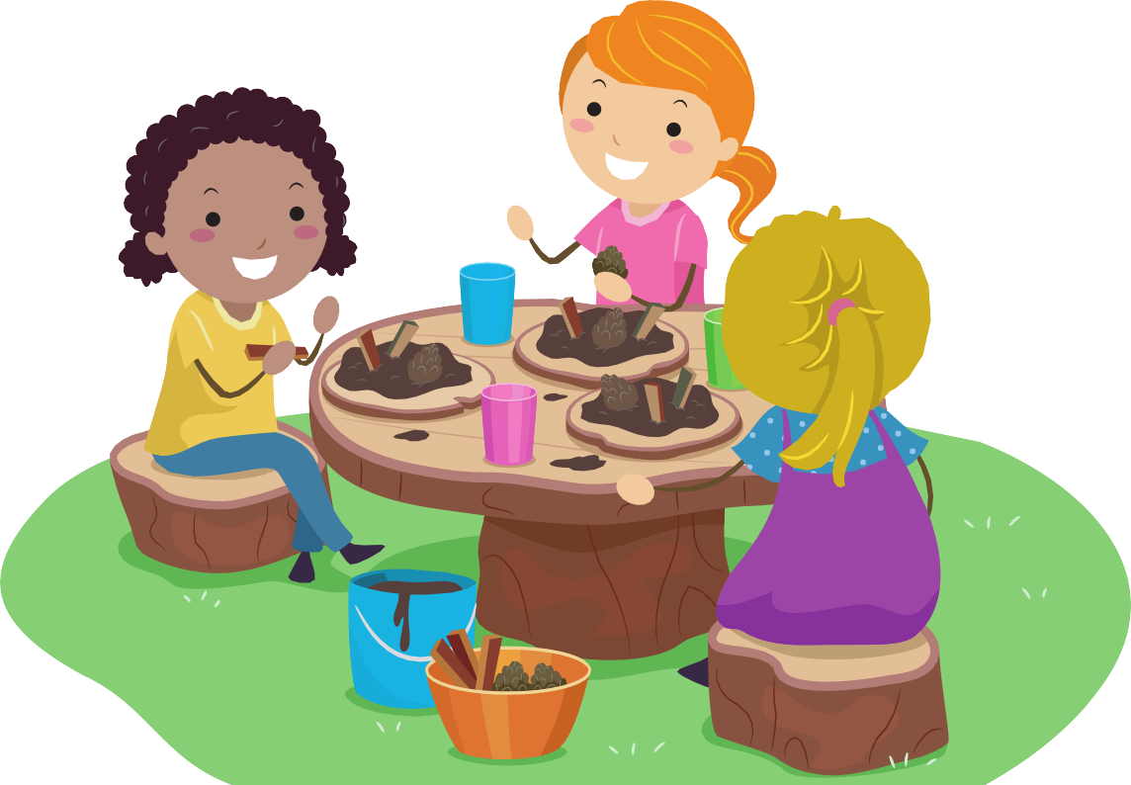
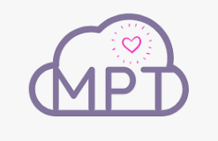
Outdoor Learning
OPAL
At St Thomas More, we have adopted the OPAL Primary Programme (Outside Play and Learning) to promote freedom for children to explore play in their own imaginative ways, using found and gathered resources in the natural outdoor environment during lunch times. Our grounds are fantastic but have been significantly underused during the winter /spring months due to the wet field area. As a result, we have decided to open up specific areas of the grounds during the winter months as long as children have the correct outdoor wear.
Please ensure that your child has a pair of wellington boots in school, which can be kept here permanently. Suitable coats/ rain suits are also recommended as the weather changes.
If you have any old wellies you would be willing to donate, we would be grateful for them too.
The Play Team are looking forward to :
- Children accessing more areas of the school grounds during the winter/spring months
- Children exploring, building dens, running, hiding, having fun and getting dirty
- Children involved in activities other than those with a sports focus
- Children taking responsibility for themselves, their games, each other, the environment and their resources
If you would like more information on OPAL, please visit their website at http://outdoorplayandlearning.org.uk
Muddy Puddles
We also follow The Muddy Puddle Approach, which is a type of outdoor learning that allows the children to be outside whilst still embedding and learning academic curriculum linked subjects. So, rather than only doing number work in books we will also take the learning outside.
For example, we could make number ladders from sticks and jump up the ladders counting in 10’s!
The Muddy Puddle Teacher ideas are all really fun and make the children feel as if they are playing whilst learning at the same time.
You can find out more and get free resources for home at:
www.themuddypuddleteacher.co.uk

Slide 19
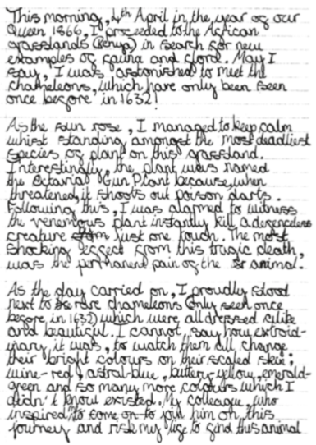
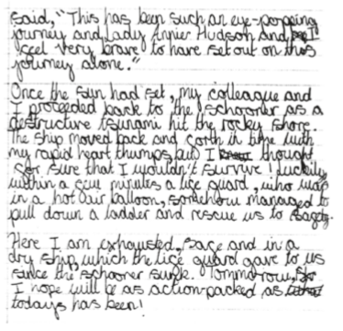
Year 6 Curriculum Expectations
An example of ‘expected’ writing in Year 6 (6S).

Slide 20
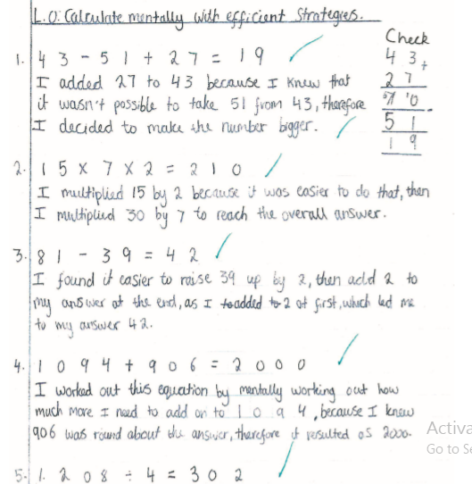
Year 6 Curriculum Expectations
An example of ‘expected’ Maths in Year 6 (6S).

Slide 21
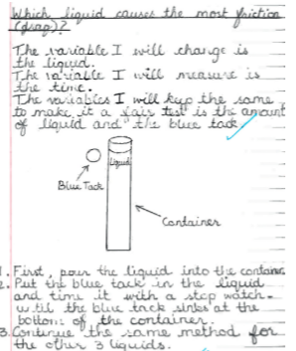
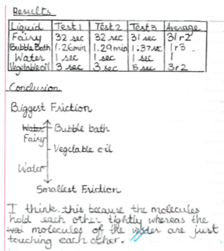
Year 6 Curriculum Expectations
An example of ‘expected’ Science in Year 6 (6S).

Slide 22
Year 6 PE will take place on Tuesday and Friday.
Indoor PE will be on Tuesday afternoon. Outdoor PE will be on Friday afternoon.
Please ensure that your child arrives at school wearing appropriate PE kit on these days. Children will be unable to participate in PE if they are wearing earrings.
This should include:
House team PE t-shirt
Navy/black tracksuit bottoms /leggings (shorts in warm weather and for indoor PE)
Navy/black sweatshirt
Socks
Trainers
Shorts and house team PE t-shirt will be required for indoor PE.

Slide 23
Behaviour
Good behaviour is celebrated through positive praise, house points, notes in diaries and telephone calls home.
Children are encouraged and expected to follow the school’s Golden Rules:
Golden Rule 1: Follow instructions. Listen to all adults working in the school.
Golden Rule 2: Be gentle, kind and polite. Keep hands, feet and unkind words to yourself.
Golden Rule 3: Value people’s belongings. Respect the school and other people’s property.
Golden Rule 4: Be honest. Tell the truth.
Restorative Justice
Restorative justice is a set of principles and practice that encourages children to take responsibility for their behaviour by thinking through the causes and consequences, it involves helping the child think through their behaviour, its consequences and what they can do to make it better.
It supports the development, maintenance and repair of relationships, it helps build a community that is based around empathy and self-learning where children take responsibility for their behaviour.
Restorative practices centre around a set of key questions that help children think about their behaviour and understand how they can correct it:
What happened?
What were you thinking and feeling at the time?
What have you thought about it since?
Who has been affected and in what way?
How could things have been done differently?
What do you think needs to happen to make things right?

Slide 24
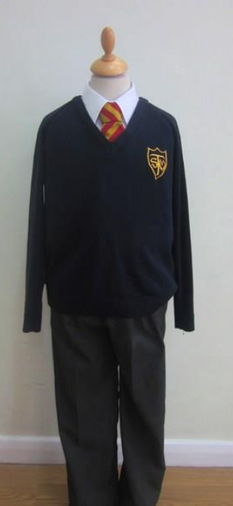
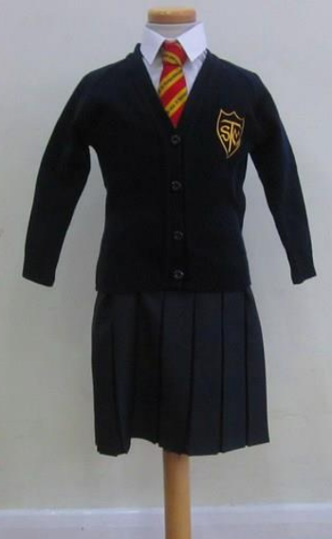
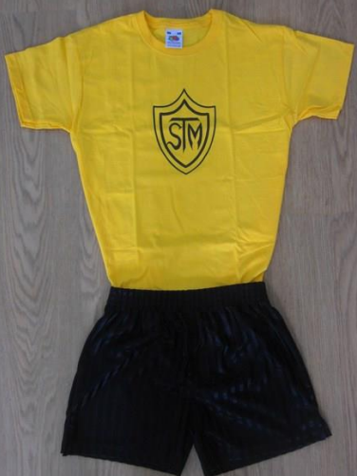

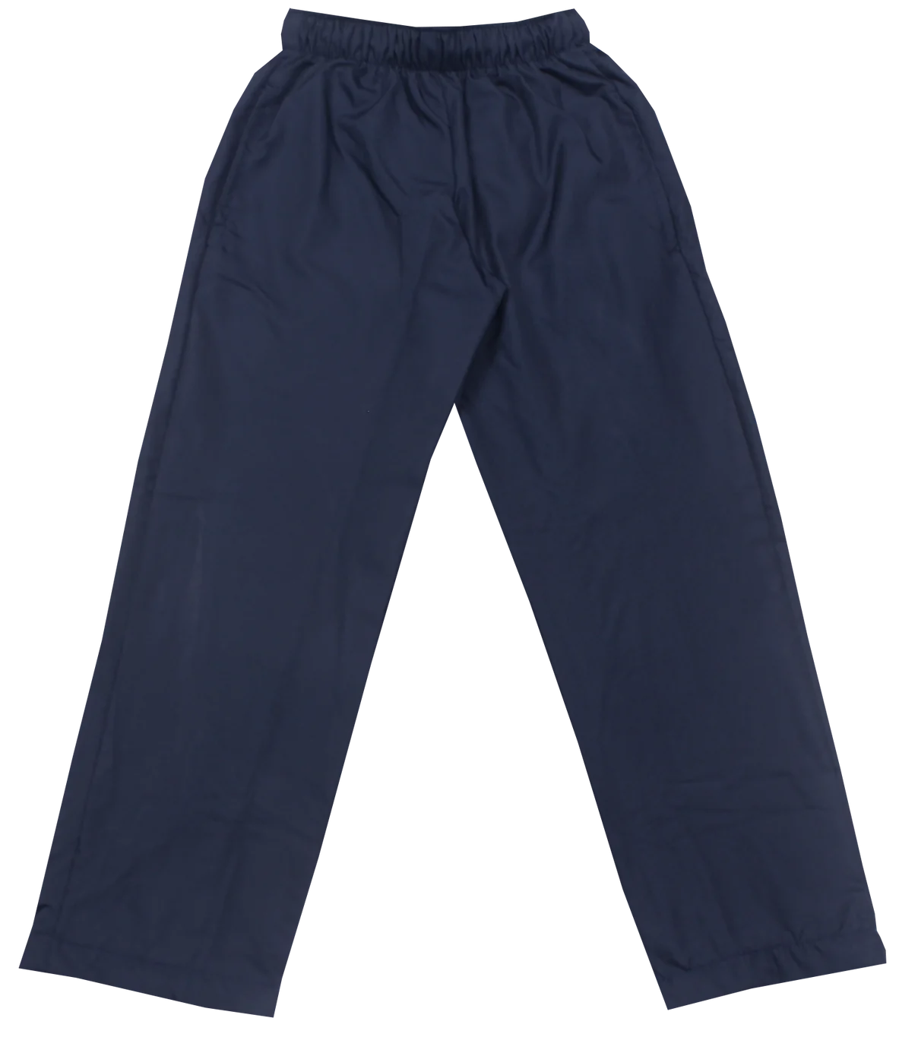
Uniform
Children should wear correct school uniform to school. Please contact the school office or your child’s class teacher if you have any queries regarding school uniform.
No jewellery is to be worn in school.
Hair longer than collar length must be tied up. Extremes of fashion such as shaved patterns/lines or partings, colours, very short hair on one side with longer on the other etc. are not allowed.
Only small hair accessories are permitted and, if worn, should be black, navy or white only. Large bows and ribbons are not to be worn.
Bags should be appropriate school bags or backpacks and practical for children’s use. Handbags and suitcases style bags are not to be used in school.
Shoes must be black or brown, no slip on shoes and no open toed sandals. Girls’ shoes should have a strap or laces over the foot so that the shoes do not slip off.

Slide 25

Homework Activities
Spellings will put on Dojo on a Monday ready for a spelling test on Friday. This will start from next week; a copy of the upcoming spellings will be given to your child to practise.
Year 6 homework will comprise of 3x CGP books covering SPAG, reading and Maths. These are 10-minute activities for each book, totalling 30 minutes for the week. Children are expected to mark and assess their homework. Children will need to hand in all 3 books for a teacher check every Monday.
There will be a homework club running every Wednesday lunch time for children to attend if they wish.
Children must read every day and this needs to be documented in your child's reading diary- your children are able to note this in their diary prior to coming to school.

Slide 26
Communication
To make contact with Year 6 teachers, please write a message in your child’s reading diary. Alternatively, a message can be left with the office and we will return your call.
If you wish to make an appointment with Year 6 teachers, please telephone the school office to arrange a suitable time to meet.
Please continue to check Class Dojo and your emails and school newsletters to keep up to date with key dates and information.
If your child will be walking home or going home with another parent, please ensure the details of this are given to Year 6 teachers in writing.

Slide 27
Housekeeping
Please label all clothing and belongings including PE Kit.
Please send in any money in an envelope clearly marked with your child’s name and what the money is for or use Parent Pay.
Children must have a water bottle in class everyday - it is really helpful if children bring more than one bottle!
Please make sure your child is bringing in a fruit based snack to eat at break time.

Slide 28
Please do not hesitate to contact your child’s class teacher if you have any queries.
Thank you for your time.
Miss Fenech and Miss Lockwood

